Slide 1
Control Chart
Rakesh Roy
Lecturer
IPE

Slide 2
Problem
San Marino Tube Lights is a famous is a famous tube light manufacturing company in North Carolina, producing around 5000 pieces of lights per day. The quality control expert planned to take samples of size 50 units each every working day. The company worked 22 days in the month under consideration. To test for quality, the expert also planned to use p-chart.
A quality inspector randomly collected and tested 50 tube lights from the production line. If they lighted on, they were considered as conforming units, whereas if they failed, the tube lights were rejected as defective units.
Data for 22 working days are shown in table.

Slide 3
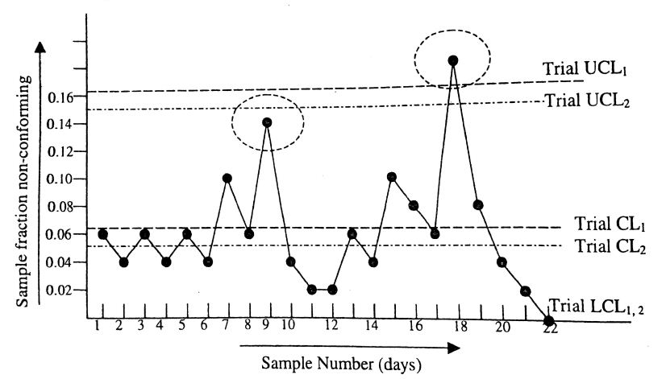
P-chart

Slide 4
Problem
A weight manufacturing company produces iron weights, produced by melting and casting irons of different grades. A weight may be considered nonconforming for many reasons – lower/ higher weight than designed, too irregular shape, visible fracture, bubbles, surface finish etc. The number of nonconformities on 22 samples, produced in January 2007, yielded the following results. Thirty (30) pieces constitute one inspection unit.

Slide 5
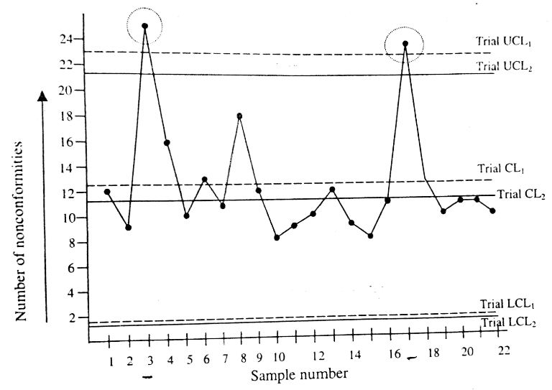
c-chart

Slide 6
Problem
A plastic door company produces doors of three sizes : 25 ,30 and 40 square feet. A door may have different type of nonconformities, such as bubbles, blemishes, scratches etc. The surface area of the door may be considered as its simple size. Since door sizes are different, sample sizes are also different. For each production lot, one door is inspected. The table shows number of nonconformities found in different doors.

Slide 7
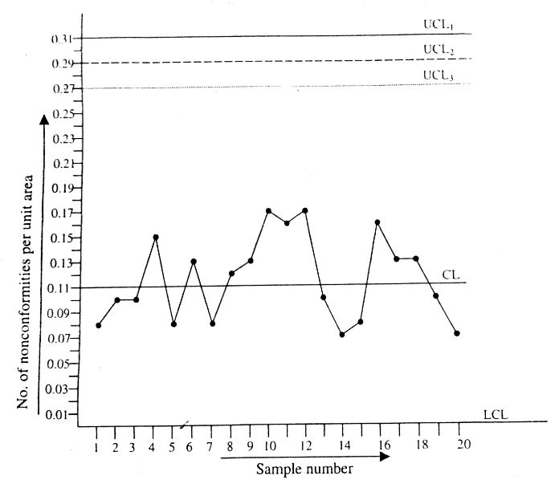
u-chart

Slide 8
Problem
Metlab Casting Company Ltd. produces steel pipes of a certain diameter, considered as a critical quality characteristic. The company decided to use X̅ - R chart to control diameter.
From a day’s production, a sample of 5 pipes is selected randomly from the production line and their diameters are recorded. The average diameter and range of this sample (of size 5) are computed and recorded in a table. The inspector collected this type of samples in 22 working days in the month of February. Thus, X̅ and R values of 22 samples are recorded in the table.

Slide 9
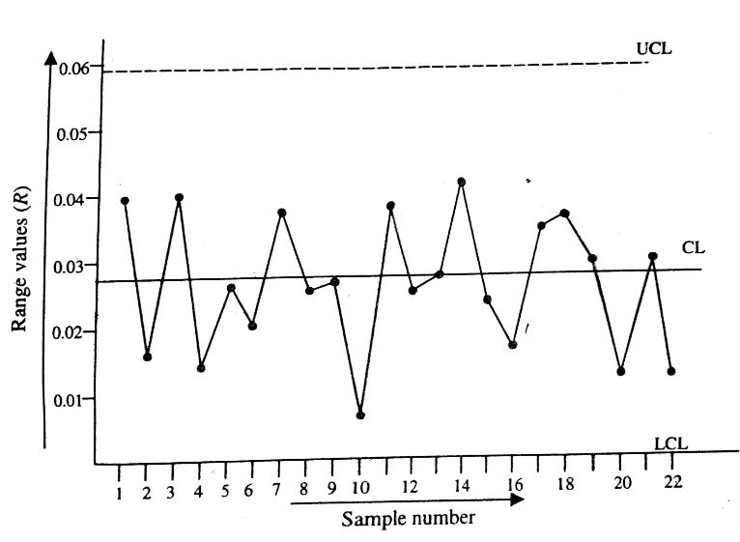
R-chart

Slide 10
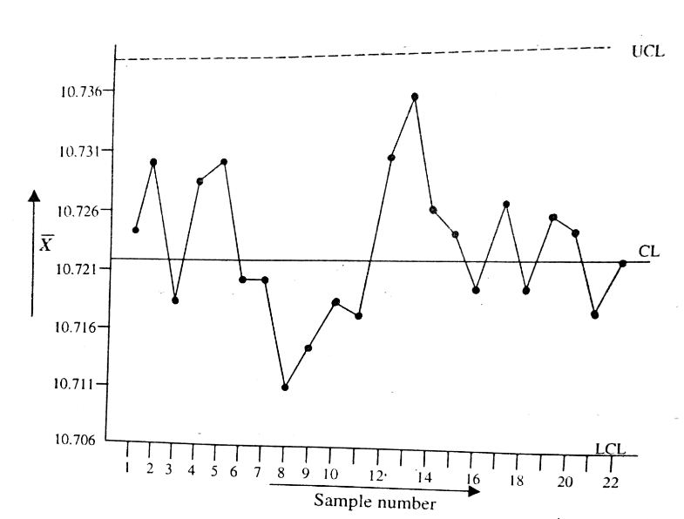
X̅- chart

Slide 11
CUSUM Chart
In a discrete parts manufacturing company, data were collected from a lathe machine, regarding diameter of a cylindrical component. The first ten samples were collected in 10 days, after which the machine was setup again after lubrication. Then another samples were collected in the next ten days. The measured diameter of thirty samples are recorded in table.

Slide 12
Shewhart control chart

